Slide 1
Introduction to NVivo:
Qualitative Coding for Text Analysis
Taught by Sean P. Rogers
Digital Integration Teaching Initiative
CRIM 4949: Senior Capstone Project
Simon Singer
Fall 2024
Feel free to ask questions at any point during the presentation!

Slide 2
Workshop Agenda
Qualitative Coding: annotating and highlighting sources
What is NVivo?
Important vocabulary and functions
Notes:
Tell students: these are reference materials for them to use throughout the semester and will not disappear

Slide 3
Workshop Objectives
Understand what qualitative coding is and why it can be useful while doing research
Understand how to use NVivo as a research tool
Learn the differences between NVivo file types and why knowing this is important
Learn important NVivo-specific vocabulary to aid independent research
Notes:
Emphasize this is what they’ll learn throughout the workshops. Decision point to refer back at the end of lecture to this slide to check off what students have learned.

Slide 4
Getting started: Qualitative Coding with NVivo

Slide 5
Qualitative Coding
Qualitative coding is when you create a list of themes, or a schema, that you want to highlight in a primary/secondary source. Then, you go through all your sources and highlight particular moments from the text according to those themes.
Notes:
Provide students with examples of research where this would be an important method: analyzing themes in literature, speeches, etc. We can think of coding themes in documents, audio, video, and social media data, and identify trends in sentiment or relationships within these data.

Slide 6
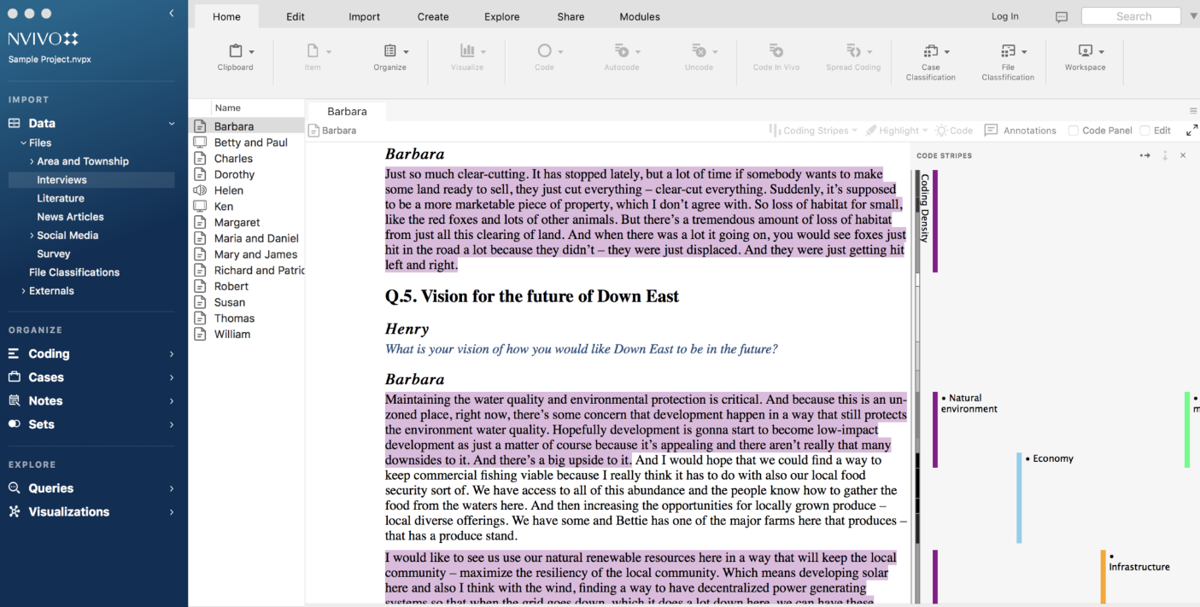
Coding in practice

Slide 7
What is NVivo?
NVivo is a text analysis and research organization software that is available through Northeastern’s Student Hub> Resources> IT Services> Software Downloads.
NVivo provides methods for you to annotate and code documents using user-created tags (codes), summarize and visualize these codes, and organize research materials. NVivo is particularly helpful for organizing and annotating research materials such as:
Primary sources: any primary sources you may be analyzing such as a letter, field notes, or a document from an archive
Secondary sources: scholarly articles you read for the literature review, newspaper articles, book chapters.
Your own notes about your project (you can even compose in NVivo!)
Notes:
NVivo is a software originally built for qualitative coding that has multiple types of text analysis formats, including qualitative coding, annotating, storing information, labeling the overall files, doing basic text analysis visualizations like word counts, and more.

Slide 8
What can NVivo do?
NVivo is designed for qualitative coding research materials, such as survey results, interviews, audio recording, text documents, articles, and other data formats. It also has other functions:
create projects that store, organize, and code documents/files
provide a method for you to code your documents with a user-created coding schema (codes)
query, summarize, organize, and visualize information about your coding
conduct forms of computational text analysis, like word counts, on the documents, themselves
conduct social network analysis with social media datasets
Notes:
Social media analysis can be done on Facebook and Youtube data, as well as pre-existing Twitter data
Ask students: Which NVivo features will help in your analysis?

Slide 9
NVivo for Annotating & Coding Sources
With NVivo, you can store and organize your primary and secondary sources together (most file types work, including images).
NVivo also allows you to annotate texts and use qualitative coding methods to highlight specific texts/images/pieces under themes.
Then you can summarize and visualize these annotations and codes.
Notes:
You can use NVivo to conduct qualitative analysis and to organize documents. We will cover how to code and organize a literature review with NVivo by importing reference files later in the presentation.

Slide 10
NVivo is NOT crossplatform friendly
The Mac and PC versions of Nvivo—as well as the version numbers—are different and have different file types.
Mac NVivo projects end in .npvx and can only open that file project type
Windows NVivo projects end in .npv, but can open both .npv and .npvx
Version numbers (11, 12, 14) also impact which projects can be opened on which platform
Notes:
why we will be showing both Mac and Windows. Versions are very different.
When you need to send an NVivo file to someone else, save it as a .QDPX file. We will talk about this more later
NVivo 14 offers a paid, add-on module for cloud collaboration with Mac and Windows users. Since it is a paid feature we will not be covering this in our workshop.

Slide 11
NVivo Vocabulary
Full definitions available on the handout
Data: your research documents & files
Codes: the ways to annotate the themes/concepts in your research.
Nodes: the themes/concepts that are user-created (NVivo 12 and older only)
Relationships: coding connections between two data items
Cases: units of analysis for your research.
Maps: visualization tool to see connections between the cases and codes
Query: a flexible way to explore and analyze your files, cases, and codes
Notes:
If you have NVivo 12 and older versions, you will notice they refer to codes as “Nodes”. These terms are used interchangeably, and NVivo 14 phases out use of the term nodes and preferences referring to tagged themes in data as codes.

Slide 12
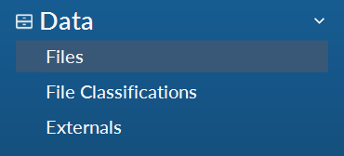
Data
The “Data” in NVivo are all the research materials you are using (scholarly articles, transcriptions, newspapers, research notes, etc.).
“Files” will be where you can access all the research materials you have imported into this project.
Notes:
Ask students: What kind of data are you thinking of using in your projects? Which kinds of data capture the issue you’re studying?

Slide 13
Important Reminders
NVivo can import all types of files, including .docx, .pdf, .doc, .csv, .png, .jpeg, .txt, video/audio files, and more.
You should always save your original documents on your local computer or in cloud storage, even if these documents are imported into NVivo. NVivo can store documents, but it is more of an organization and analysis tool, rather than a storage option.

Slide 14
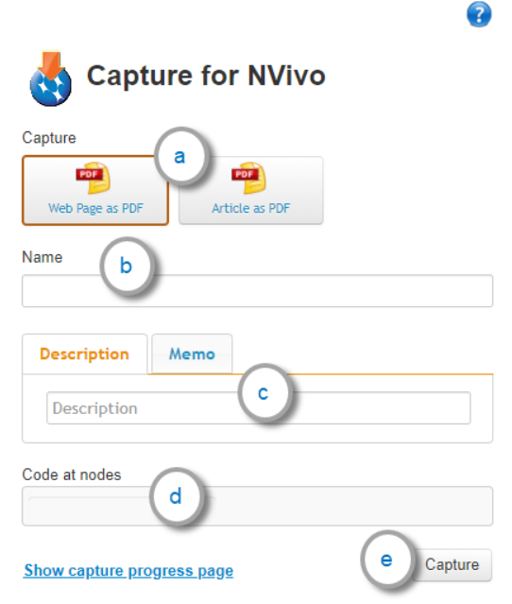
NCapture
NCapture is a free Chrome extension to capture web pages, online articles, Facebook and Youtube content and add annotations, memos, and codes. The captured content is saved as an NCapture file (.nvcx) which you can import into your NVivo project.
Please be mindful of obtaining consent for individual information you are capturing. Be aware of the current website terms and conditions when capturing data.
Select a capture type.
Review the file name
Enter a short description or a memo
Optionally, enter one or more codes
Click Capture.
Notes:
https://help-nv.qsrinternational.com/14/win/Content/ncapture/ncapture.htm

Slide 15
Ethical Considerations
Contextual Privacy
When we think about privacy online we want to think of it as contextual. What someone might be comfortable saying in one context might not be something they’re okay saying to a researcher.
Keeping People Safe
It is risky to publicize the username, profile picture, or exact text of a social media post or profile.
To show example posts etc, you can make up your own or heavily redact them.
What information would you be comfortable with sharing?
Notes:
Be mindful of terms & conditions when capturing content.
Ask students: What information would you be comfortable with sharing to a researcher vs posting to social media?

Slide 16
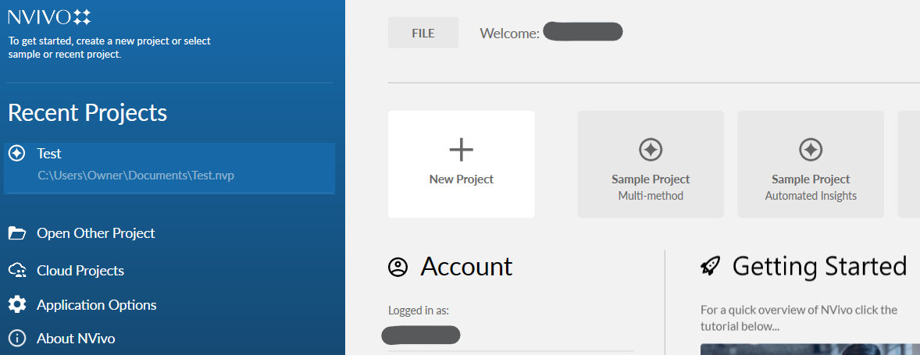
Anatomy of NVivo: Opening on Windows
The recent projects you opened
Create a new project (stores all your documents, codes, etc)
Open another project that is not recent
Your version number (you should have version 12 or 14)
Notes:
You can also open cloud projects if you add on this module, but since it a paid feature, we will not cover that in this class. When you open a new project in Nvivo 14, you can opt to auto-save projects and set a file location for project recovery. Or, you can choose to set save reminders for every 15, 30 minutes, etc.

Slide 17
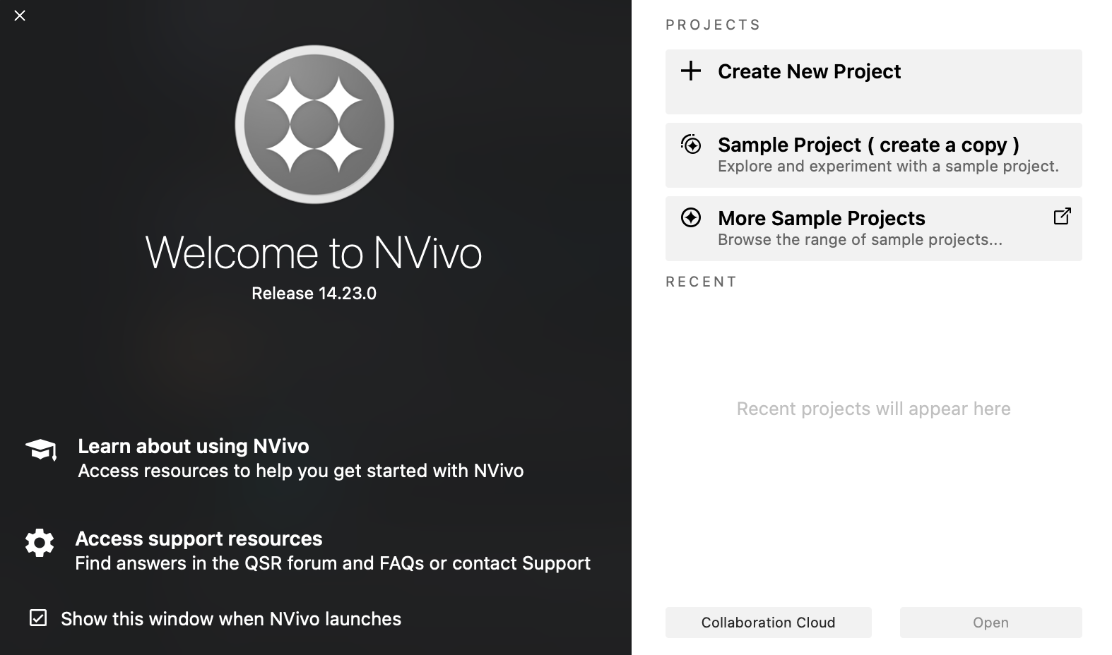
Anatomy of NVivo: Opening on Macs
Create a new project (stores all your documents, codes, etc)
Your version number (you should have version 12 or 14)
The recent projects you opened
Open another project that is not recent

Slide 18
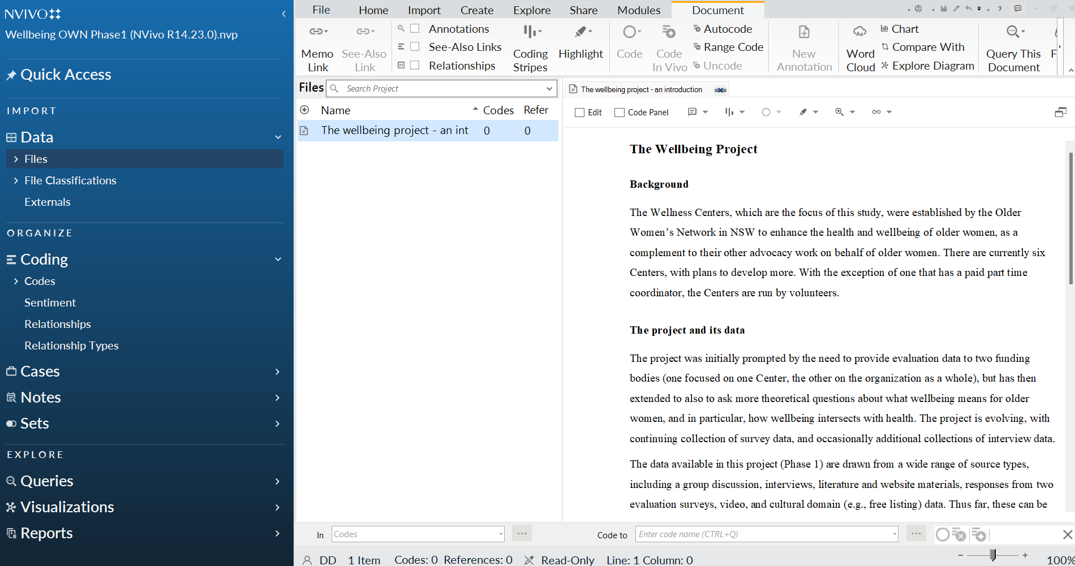
Anatomy of NVivo: Projects on Windows
Toolbar to access functions
Menu to access files, codes, cases, notes, etc.
The window that will open the files, queries, etc. You can annotate documents here.
List of codes, files, etc.

Slide 19
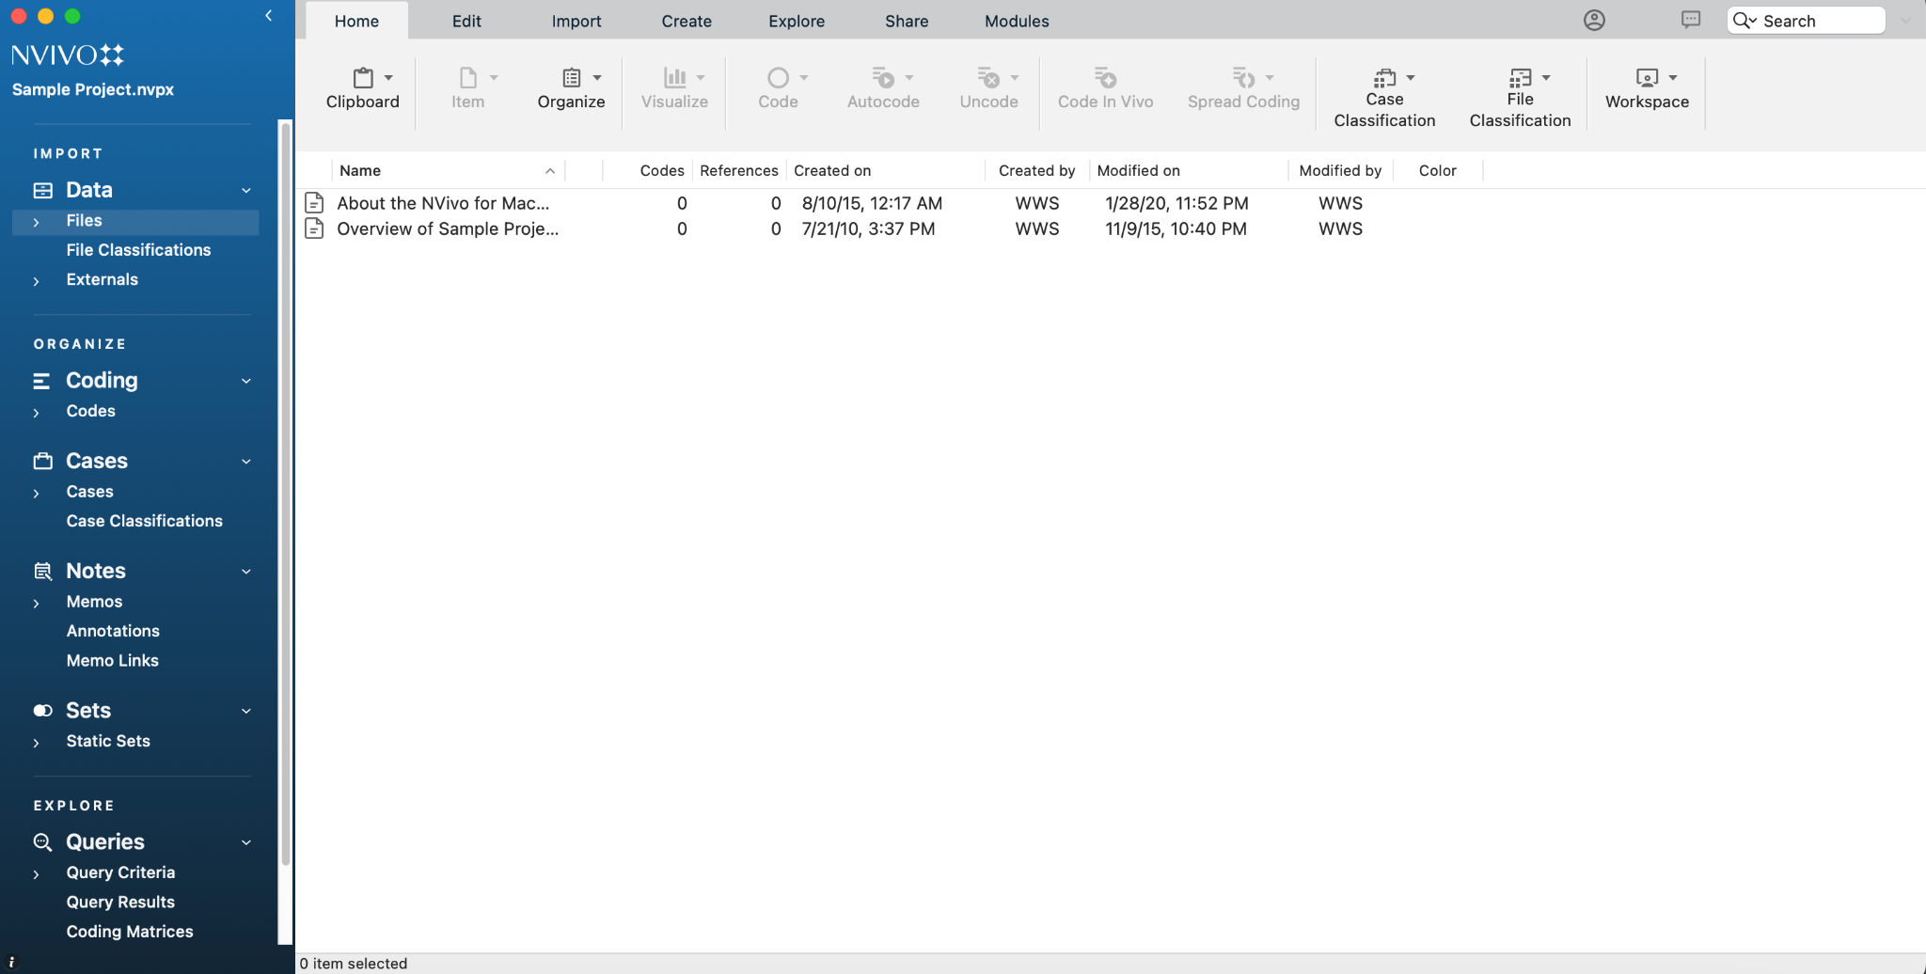
Anatomy of NVivo: Projects on Macs
Toolbar to access functions
Menu to access files, codes, cases, notes, etc.
The window that will open the files, queries, etc. You can annotate documents here.
List of codes, files, etc.
Notes:
Pause for questions and ask students to open Nvivo with the sample transcript. Mention user profiles as a way to record intercoder reliability.

Slide 20
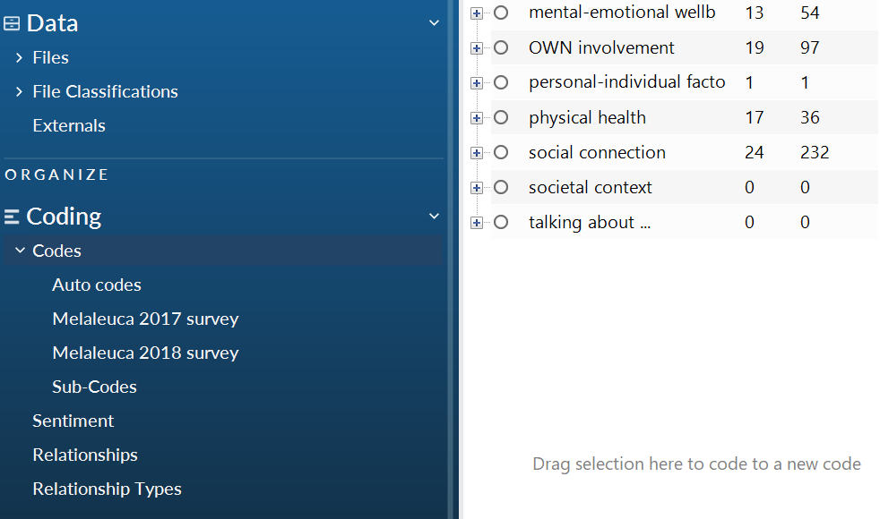
Codes
The list of themes or codes you will use to code your files. The “codes” folder will be empty until you add your own! You can add codes and sub-codes.
Notes:
Codes are themes you identify in the data. Coding identifies all the portions of data (text, audio, video, images) that are relevant to the themes. You can create sub-folders with codes showing hierarchy in coding for example. In NVivo 14, you can code for sentiments, relationships, and relationship types within data.

Slide 21
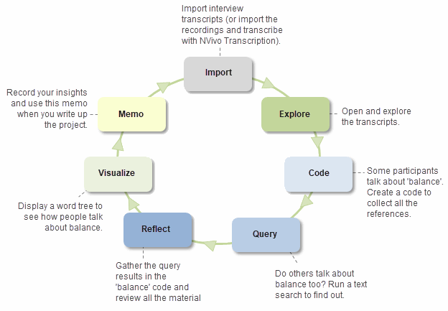
The codes you create are themselves arguments; you are choosing what information you value and want to extract from the transcripts.
This is often an iterative process.
Qualitative Coding is about Interpretation and Arguments
Notes:
Ask students: What content and themes in data are important to address your research question?
https://help-nv.qsrinternational.com/14/win/Content/concepts-strategies/using-nvivo-for-qualitative-research.htm

Slide 22
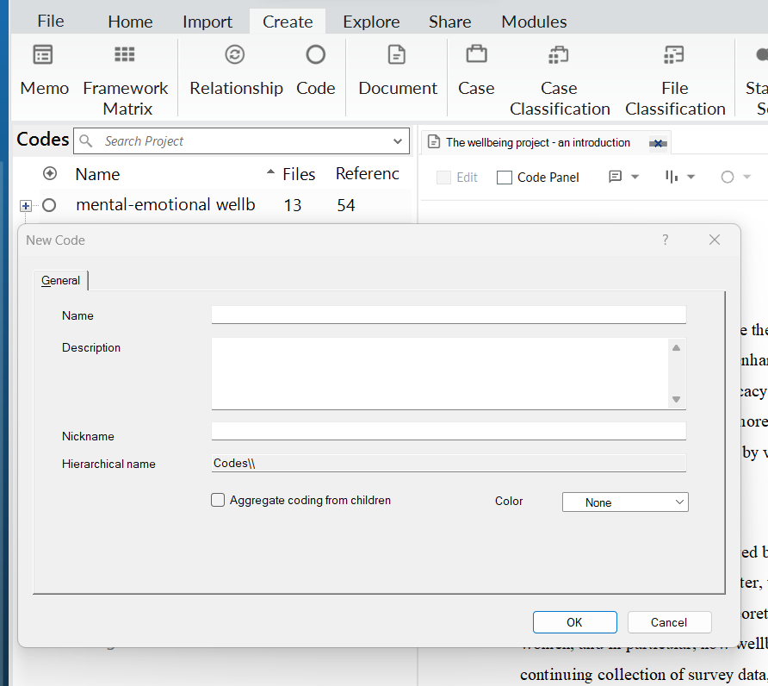
Creating Codes (Windows)
1
Go to “Create” in the toolbar
Click “Code”
Your new code will pop up and ask for a name and description
To add a subcode, follow the same steps, but click on the original code where you want to add the subcode
2
3

Slide 23
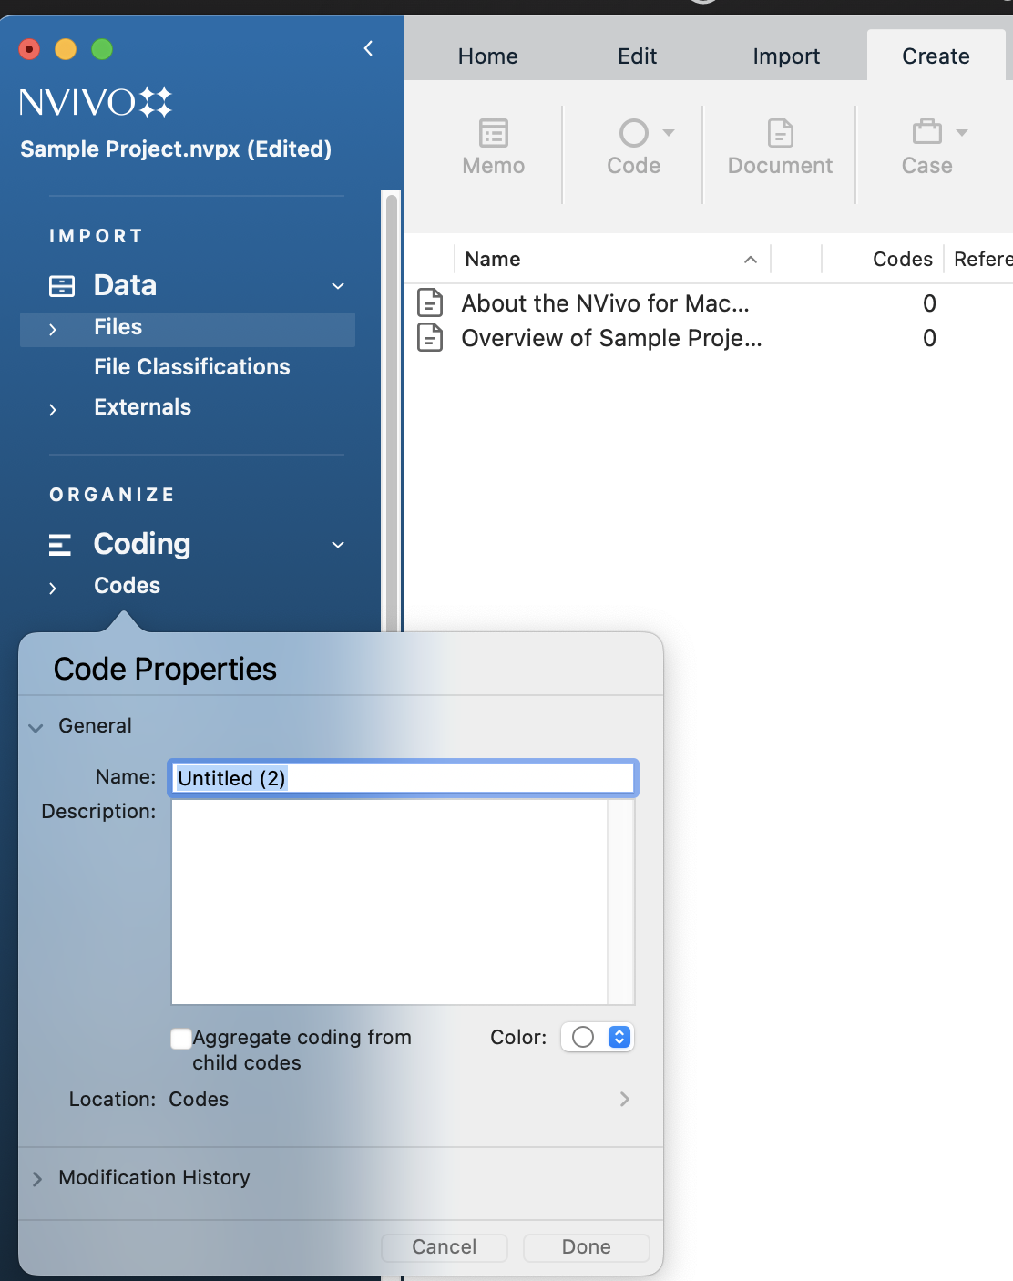
Creating Codes (Macs)
Go to “Create” in the toolbar
Click “Code”
Your new code will pop up and ask for a name and description
To add a subcode, follow the same steps, but click on the original code where you want to add the subcode

Slide 24
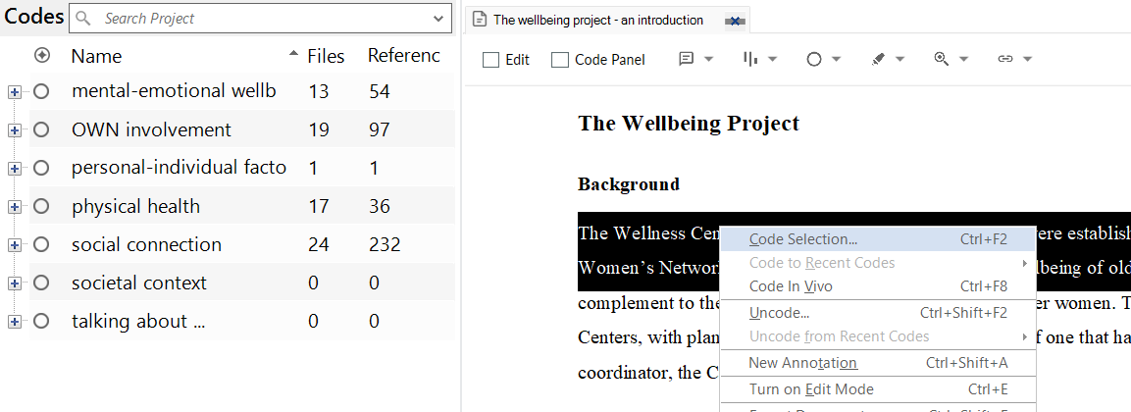
Coding Files/Documents (Windows)
Open the file you would like to annotate.
Highlight the text you want to code.
Drag and drop the selection onto a code.
Alternatively, you can right-click and select “Code.”
You can also add new codes/cases as you annotate.
Notes:
Show where to uncode as well.
https://help-nv.qsrinternational.com/14/win/Content/coding/coding.htm

Slide 25
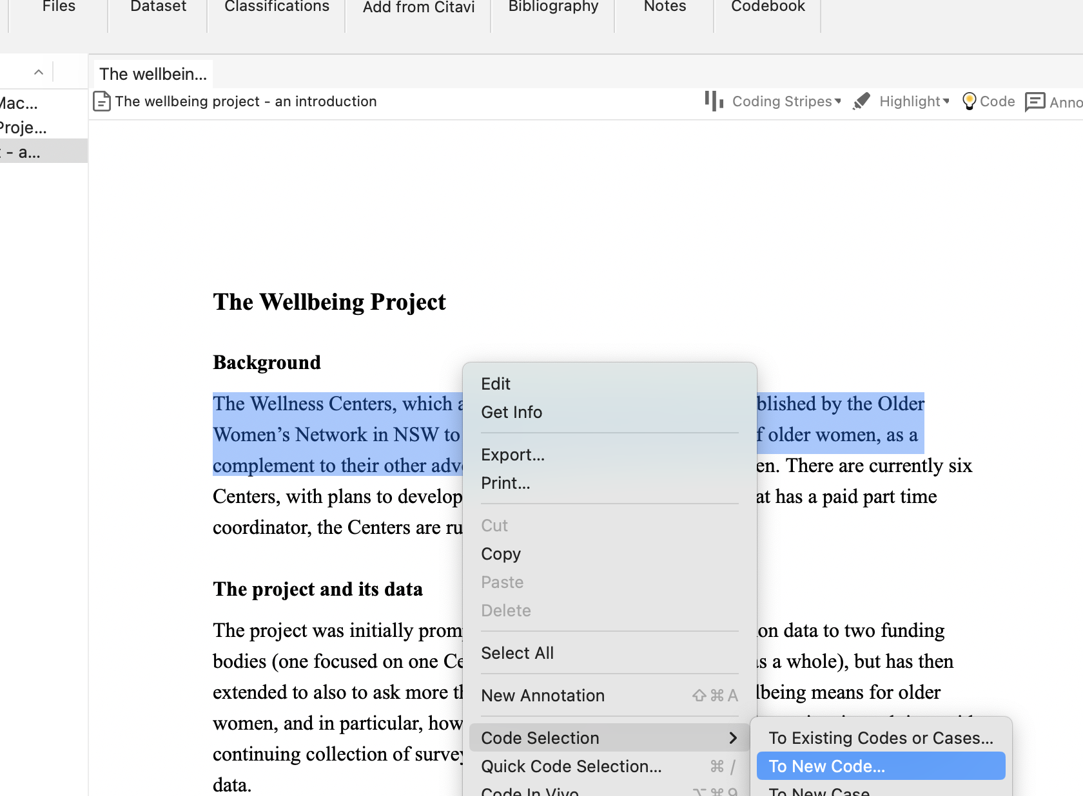
Coding Files/Documents (Macs)
Open the file you would like to annotate.
Highlight the text you want to code.
Control-click and go to “Code Selection.”
Click “At Existing Codes or Cases”
Once you use codes, the codes will show up when you click “Code Selection.”
You can also add new codes/cases as you annotate.
Notes:
https://help-nv.qsrinternational.com/14/win/Content/coding/coding.htm

Slide 26
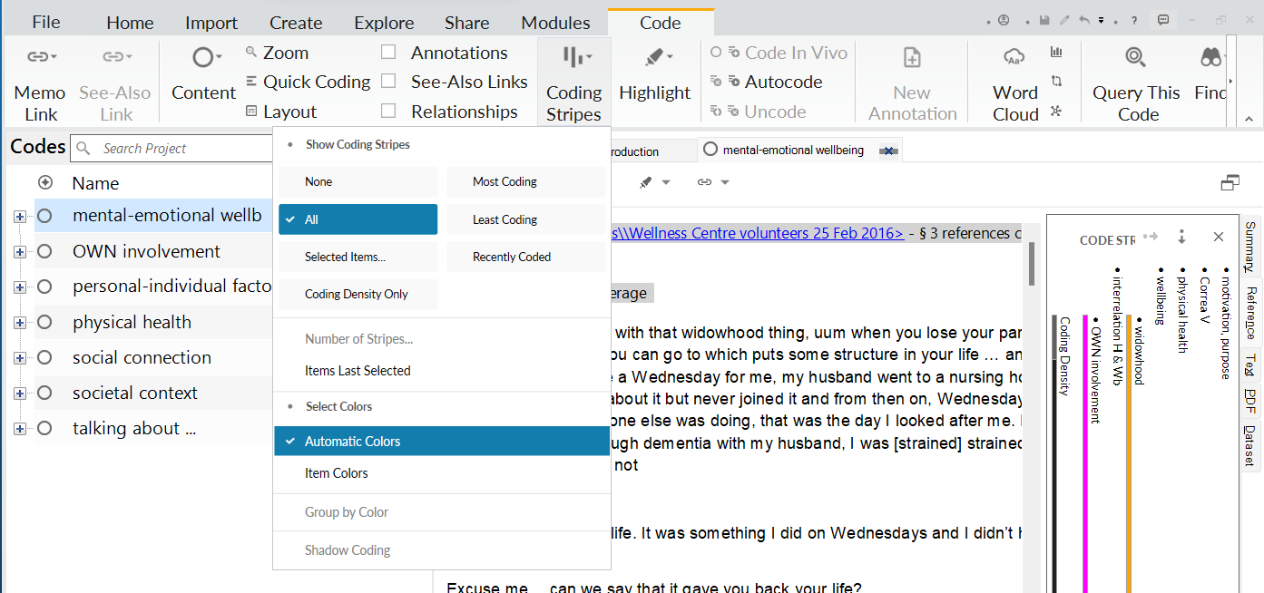
View Your Codes (Windows)
Go to “Document” in the toolbar
Click “Highlight” then “All Coding”
Click “Coding Stripes” and “All Coding” to see the code names and where they appear in the document.
If you have tagged an entire file as a “case,” everything will be highlighted. Choose “Coding for Selected Items” to select which codes you’d like to view.
1
2
Coding stripes (shows what codes appear where in the doc)
3
The document you are coding and annotations

Slide 27
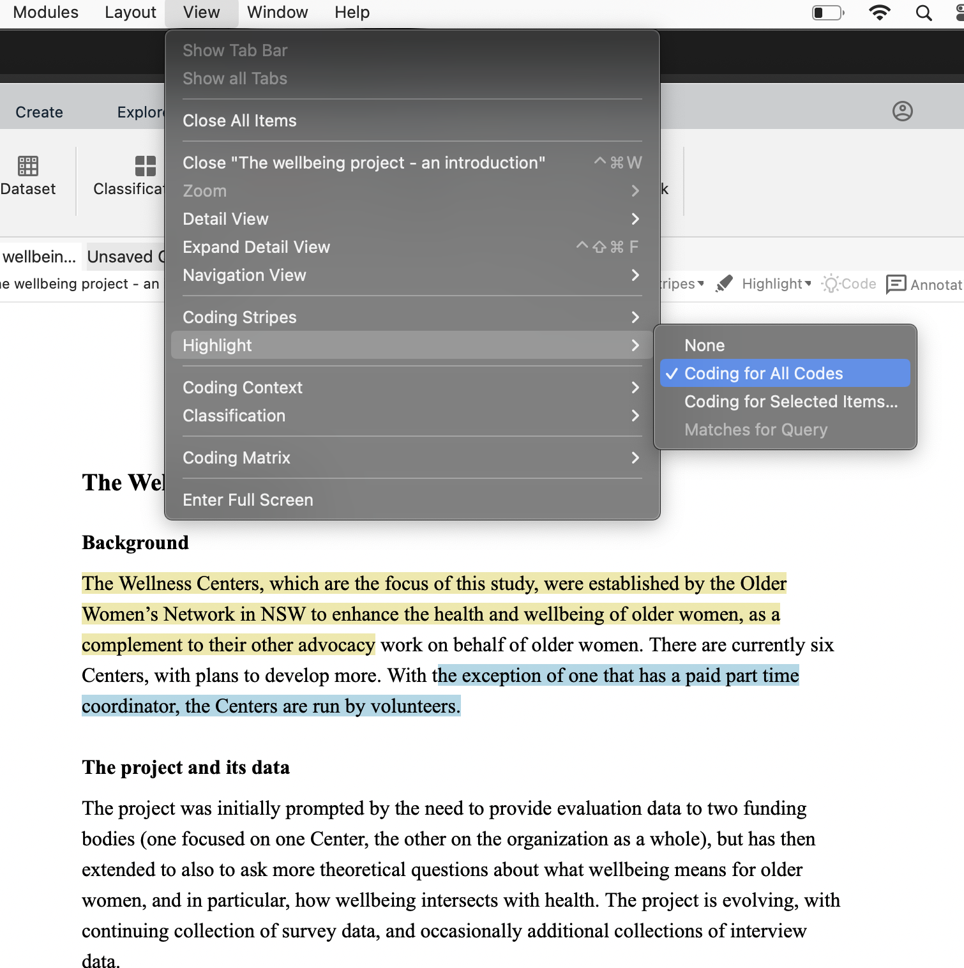
View Your Codes (Macs)
Go to “View” in the toolbar
Click “Highlight” then “Coding for All Codes”
Click “Coding Stripes” and “All Coding” to see the code names and where they appear in the document.
If you have tagged an entire file as a “case,” everything will be highlighted. Choose “Coding for Selected Items” to select the codes you’d like to view.
Coding stripes (shows what codes appear where in the doc
Your document you are coding and annotation (yellow = codes, blue = annotations)

Slide 28
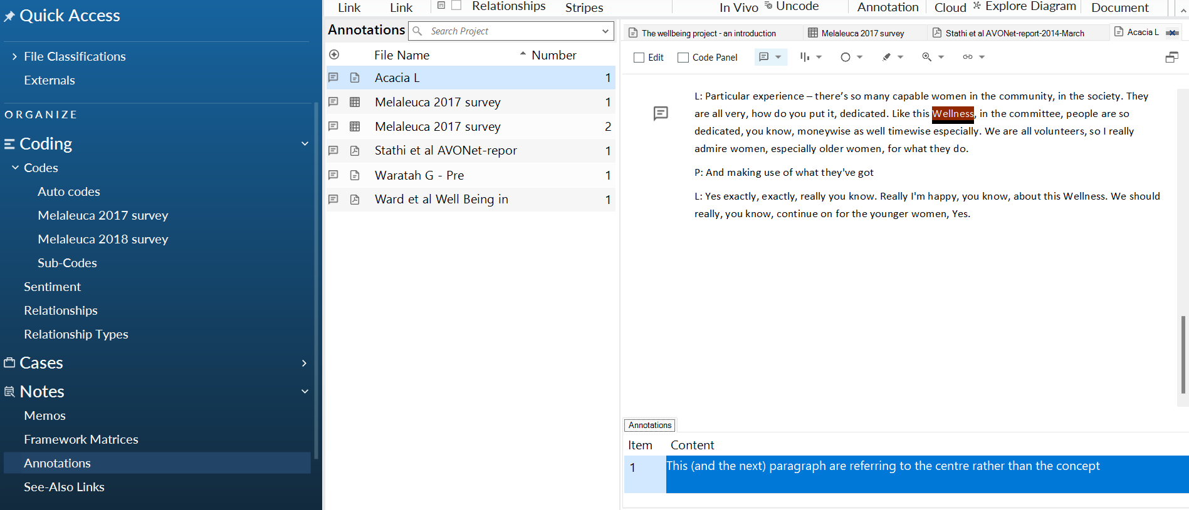
Annotating Files (Windows)
To annotate (comment), follow the same steps as coding except instead click “New Annotation” after you highlight and right click. Find all your annotations in the “Notes/Annotations” section in the left menu
The text from the document you highlighted and are annotating
List of annotations
Where you can find all your annotations listed
Your annotation
Notes:
https://help-nv.qsrinternational.com/14/win/Content/notes/annotations.htm

Slide 29
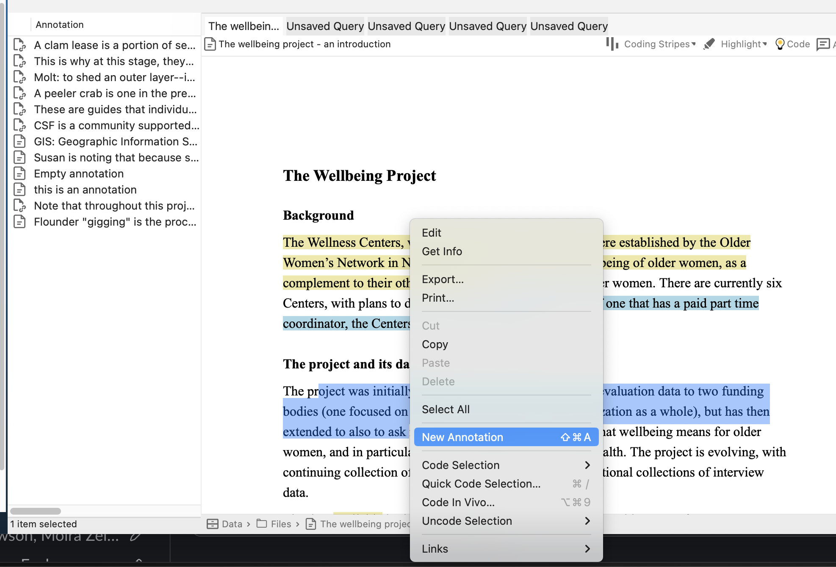
Annotating Files (Macs)
To annotate (comment), follow the same steps as coding except instead click “New Annotation” after you highlight and control-click to reach the pop-up shortcut menu. Find all your annotations in the “Notes/Annotations” section in the left menu
List of annotations
The text from the document you highlighted and are annotating
Notes:
https://help-nv.qsrinternational.com/14/win/Content/notes/annotations.htm

Slide 30
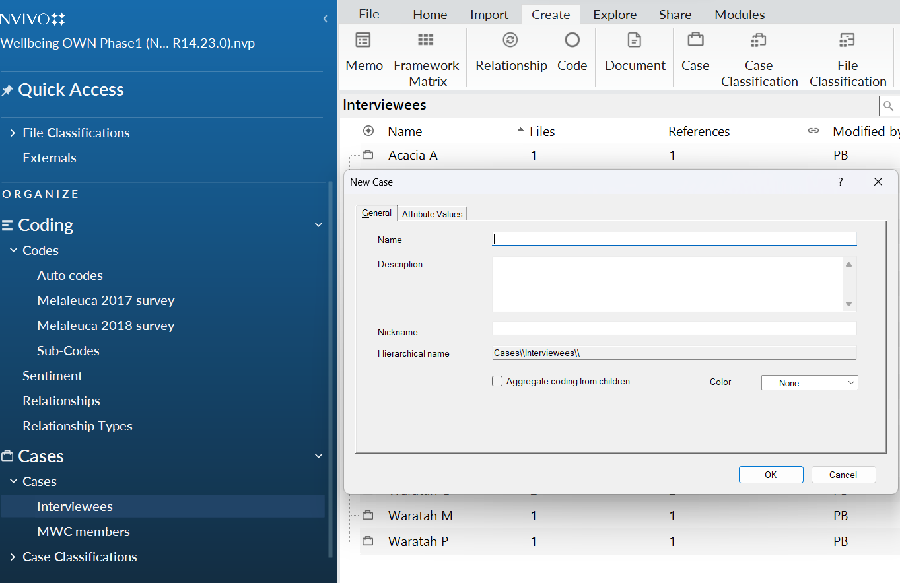
Cases (Windows)
To add a “case” to a file, it’s the same method as adding a code, except you choose the “Cases” folder and the proper case.
Cases are the types of research texts in your project and can be organized based on the user’s choice. “They might represent people, places, events, organizations or other entities that you want to analyze and compare.” For example, if you have several transcripts from different trials, but want to categorize the type of trial for each text, you would use cases to do so.
-“About Cases”, NVivo

Slide 31
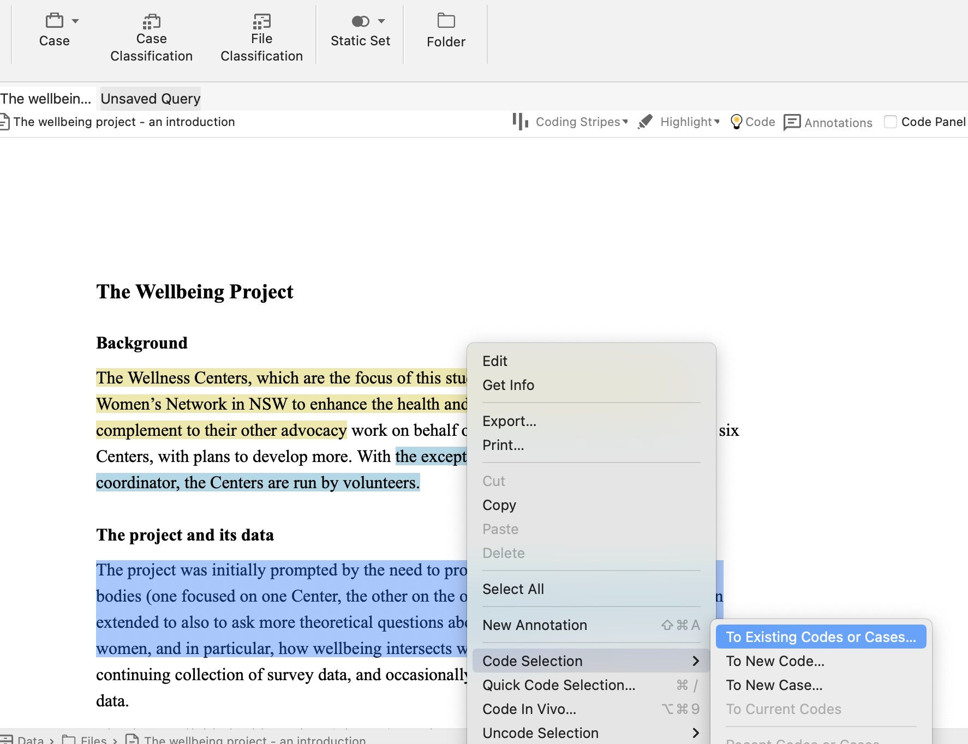
Cases (Macs)
To add a “case” to a file, it’s the same method as adding a code, except you choose the “Cases” folder and the proper case.

Slide 32
Querying
Querying, or asking something from your data, in NVivo provides multiple ways to explore both your codes and your text.
Word Frequency: Counts the number of times words (with stopwords removed) appear in one or more files. Stopwords have non-significant meaning and appear frequently, like “the”, “a,” “is,” etc. They can inflate word frequencies without adding meaning, and are typically removed.
Coding: Shows the number of codes, text that was coded, and the files.
Crosstab: cross reference codes and case classifications. For example, you might want to know how often a particular code appears in both scholarly articles and your primary texts.
Notes:
Mention this related to data cleaning

Slide 33
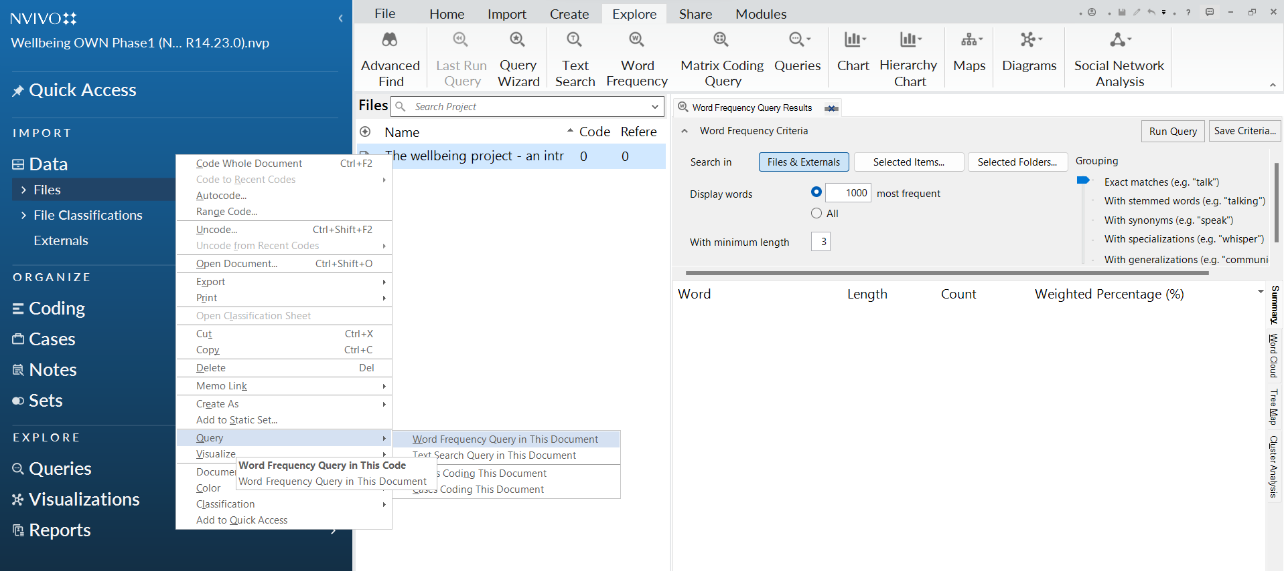
Word Frequency Example (Windows)
“Query” can be found in the “Explore” Tab
Alternatively, you can right click on a file and select Query
To query multiple items, select the items you would like to query in the “Selected Items” tab and then click “Run Query”

Slide 34
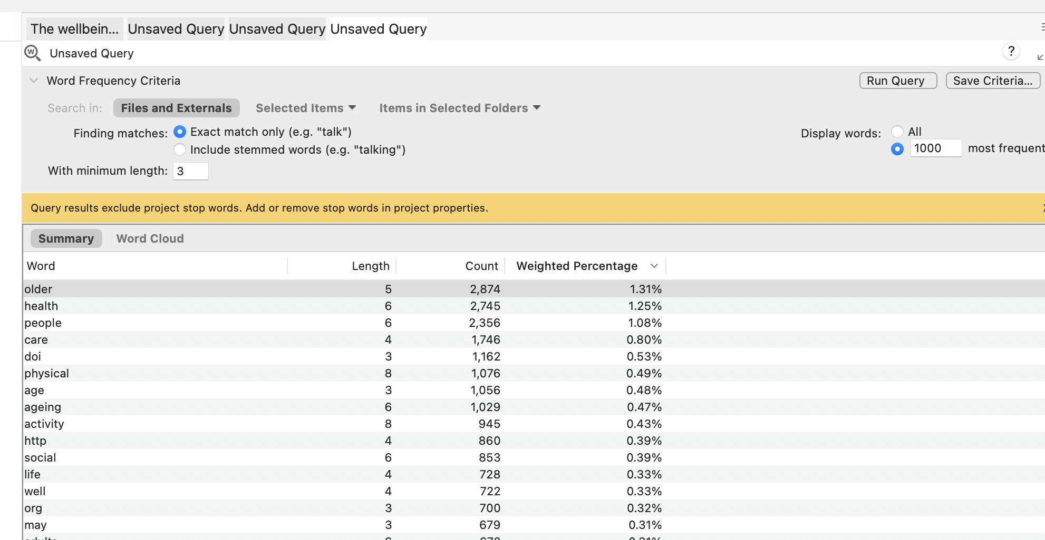
Word Frequency Example (Mac)
Click the word frequency tab, then select the items you would like to query in the “Selected Items” tab and then click “Run Query.”

Slide 35
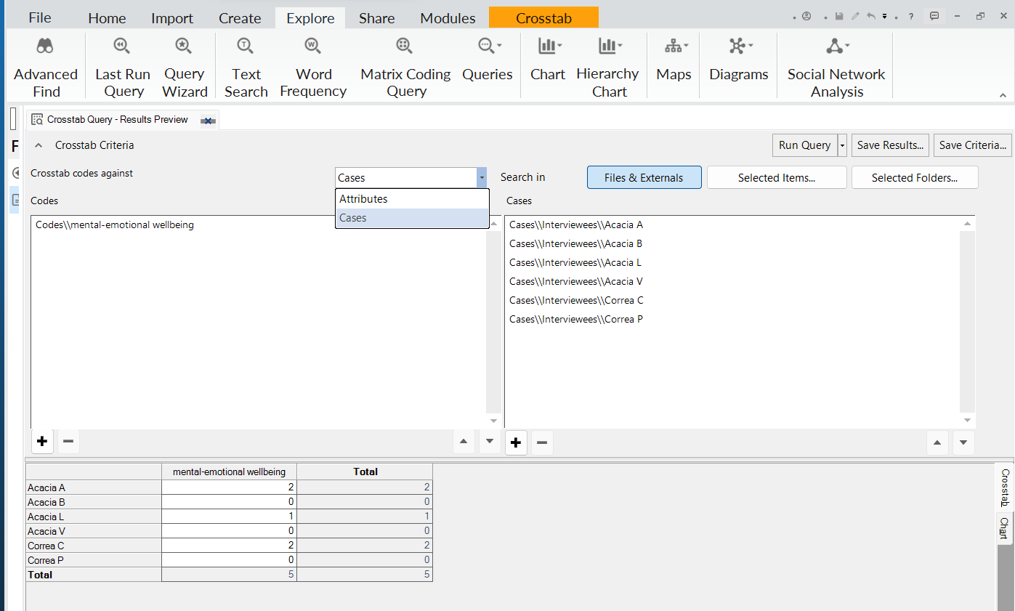
Crosstab Example (Windows)
Select the codes you would like to cross reference with the cases or attributes, then click “Run Query.”
Selected codes (click the plus sign)
Selected cases (click the plus sign)
Your results

Slide 36
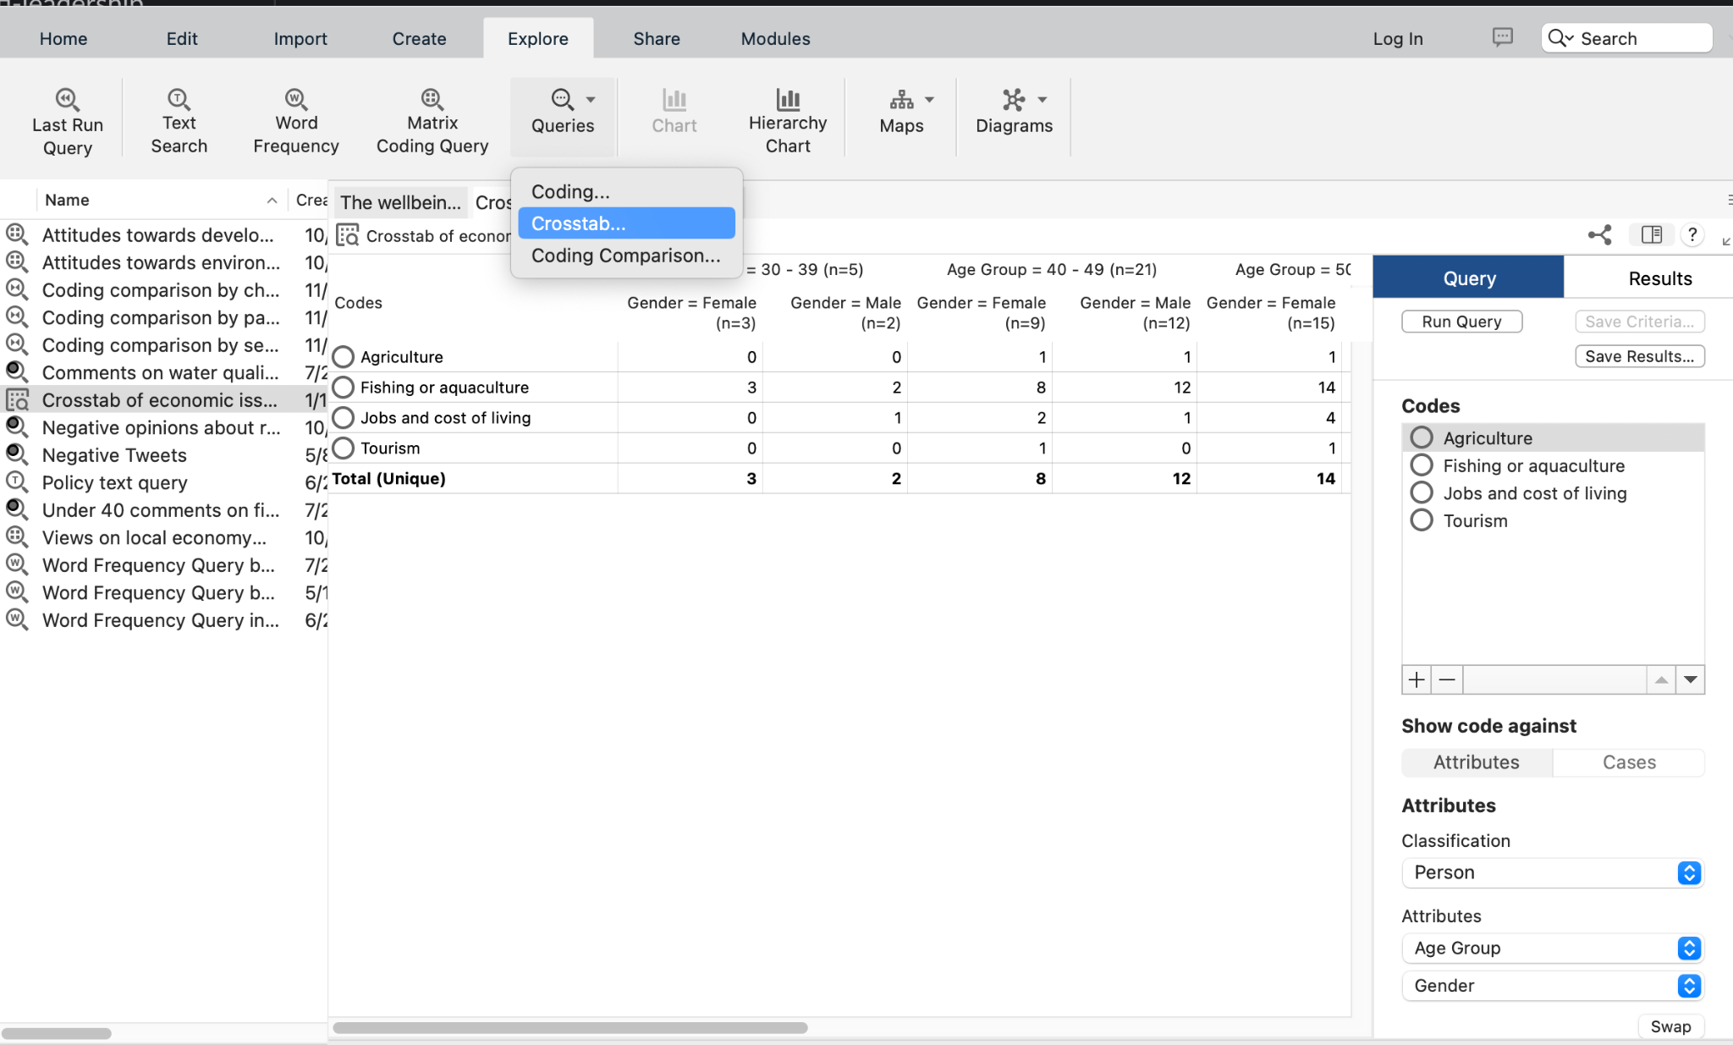
Crosstab Example (Mac)
Hit Explore, Queries, then Crosstab, and Select the codes you would like to cross reference with the cases or attributes, then click “Run Query.”
Selected codes (click the plus sign)
Your results
Selected codes
Selected cases (click the plus sign)

Slide 37
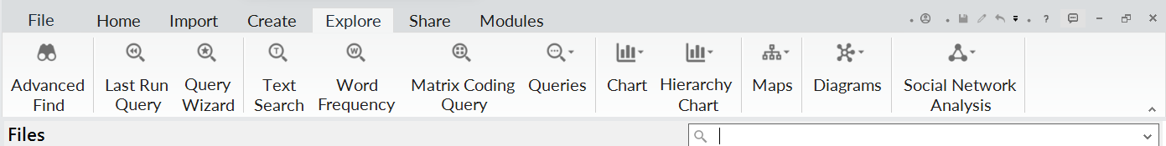
Exploring Codes (Windows)
Chart: bar chart of the number of times codes were used in a file Hierarchy chart: visualizes number of codes used in a file Explore Diagram: explore the codes used in a file Comparison Diagram: compare the codes used in multiple files Social Network Analysis: visualize relationships within networks
Notes:
https://help-nv.qsrinternational.com/14/win/Content/vizualizations/visualizations.htm

Slide 38
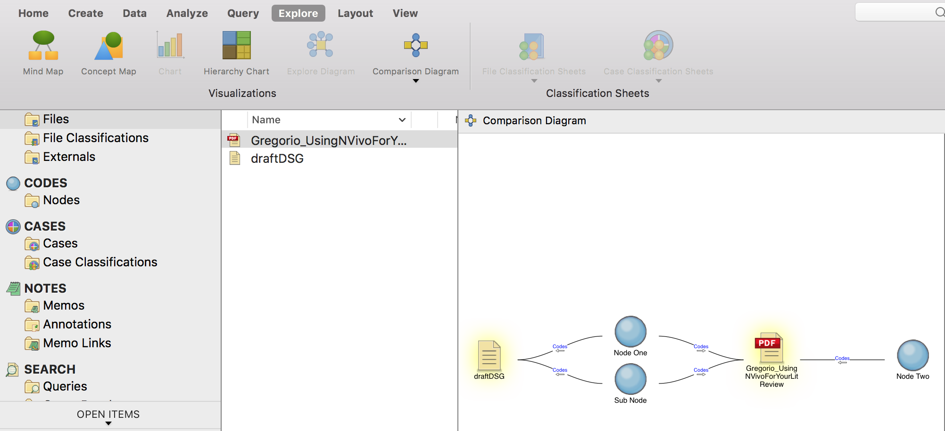
Exploring Codes (Macs)
Comparison diagram example
Notes:
You can use comparison diagrams to see:
Which sources have been coded at particular codes.
When two cases have talked about the same topic.
What two project items have in common, and what is unique to each item.

Slide 39
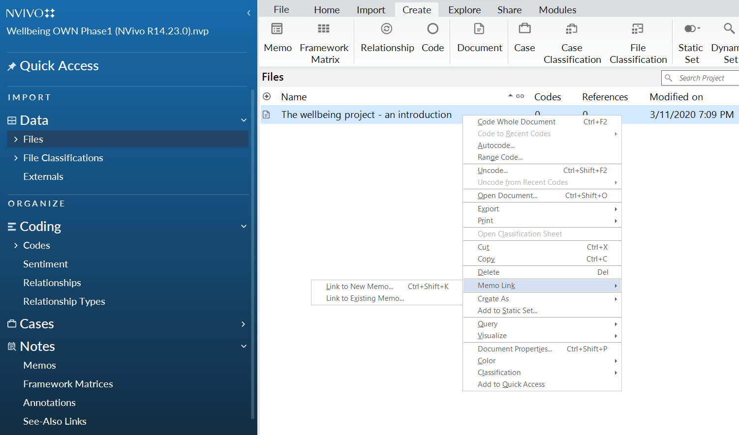
Memos (Windows)
Memos are more extended write-ups of your analytical insights
They can stand alone, but also be linked
“Memo link”: linking memo to a particular file, case, or code
Option to link the memo to a code or file
Menu where memos are located
Notes:
Memos can be queried

Slide 40
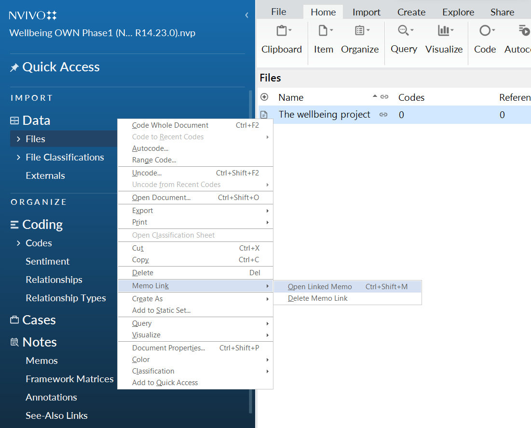
Memo Links (Windows)
Showing the link between the file and the memo
Accessing the memo from the file

Slide 41
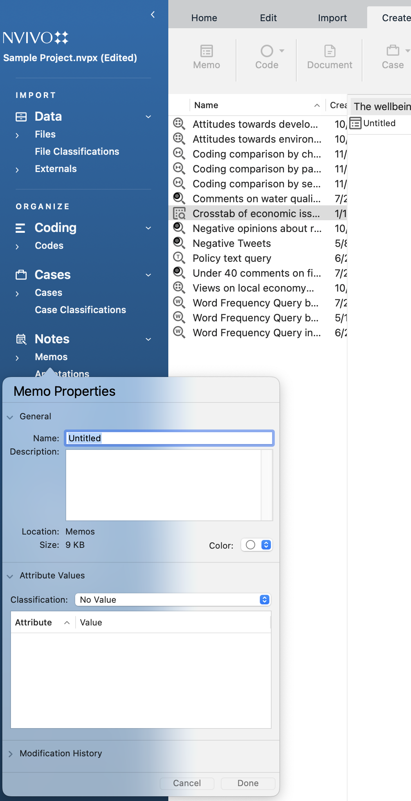
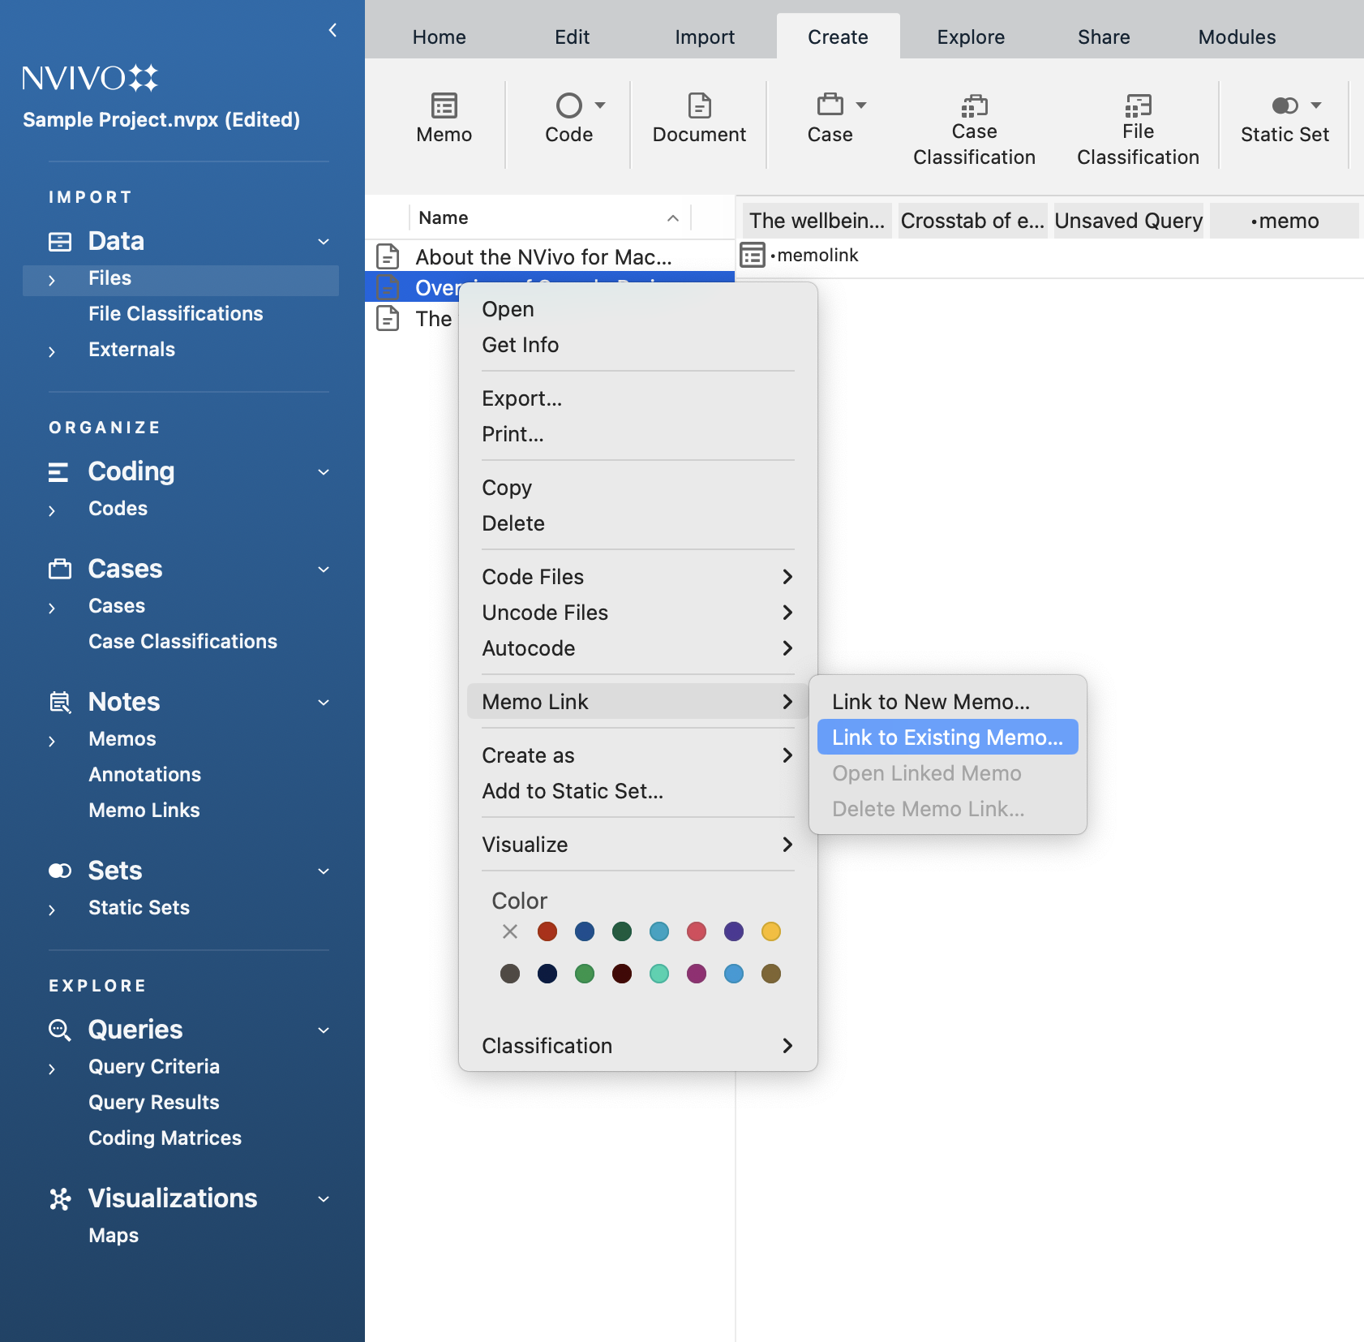
Memos and Memo Links (Macs)
Navigating memo creation (hit create,then memo)
Navigate to the file, then right click and hit memo link and choose a new or existing memo
Menu where memos are located

Slide 42
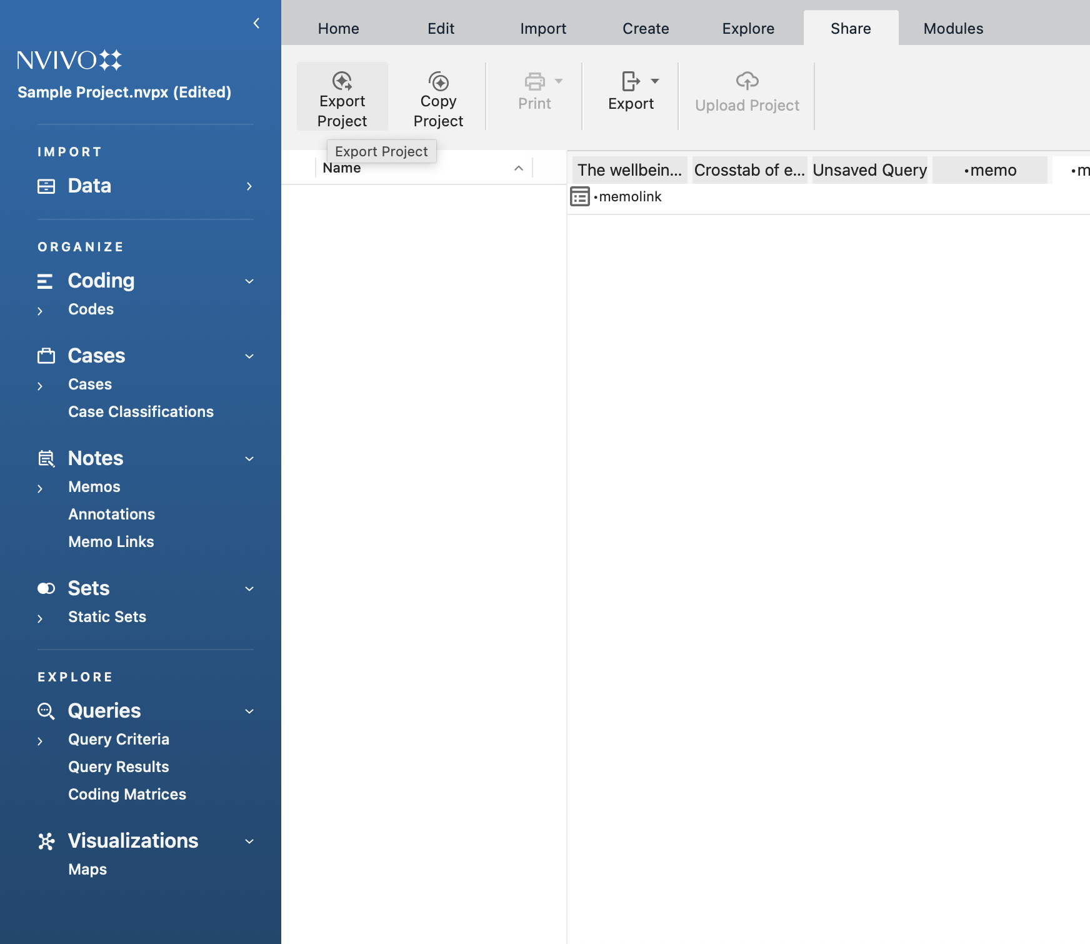
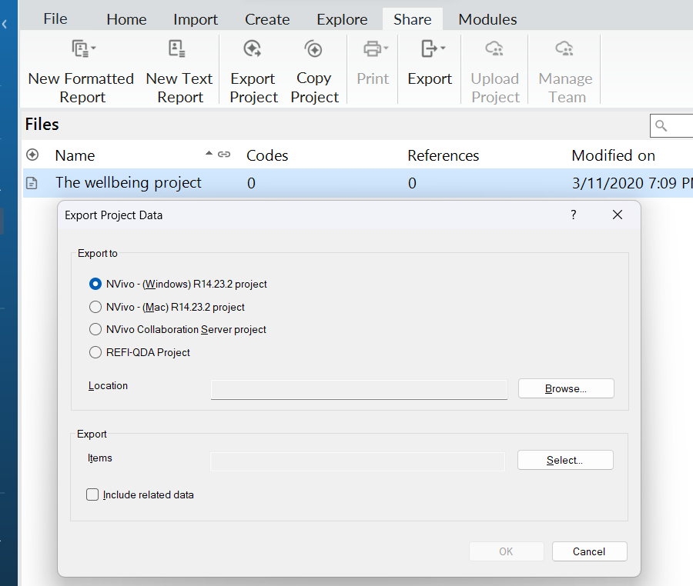
Export Your Projects
Since there is a cross-platform problem, save and export your projects as .qdpx files when submitting assignments so they can be opened on both Macs and Windows!
MACS WINDOWS
Notes:
NVivo 14 offers auto-save or save reminders every 15, 30 minutes (whichever you set) when you create a new project.

Slide 43
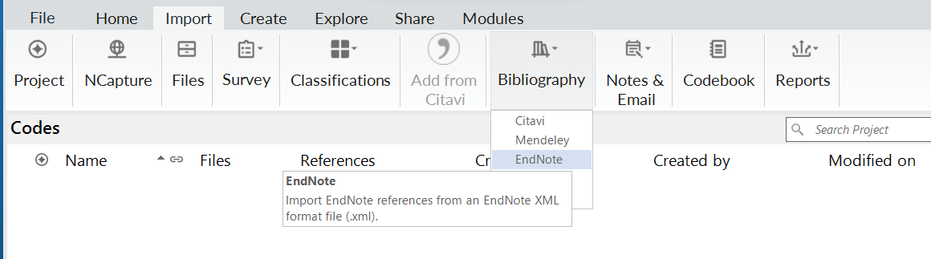
Coding & Organizing Literature Reviews
You can import reference files from EndNote, Zotero, and other citation management tools to organize a literature review. In your citation management tool, export the library as an XML (EndNote) or RIS file (Zotero).
Select the XML or RIS file from your directory.
Choose to display references by Author and Year, or Title.
Option to assign data to the Reference classification, or to other classifications (book, journal article, etc).
Option to replace attributes
or memos with file notes, abstract,
and keywords.
Click Import.
Import tab
Select Bibliography and choose the citation tool
Notes:
https://help-nv.qsrinternational.com/14/win/Content/files/reference-management.htm
When you select the option to replace current memos or attribute values with notes, abstract, and keywords, you lose existing data that you may have had as memos or attributes in EndNote or Zotero. When you choose to replace memos with abstracts, keywords, and notes, you gain the ability to code and query this information. You can code text in files, highlight quotes, run queries and matrix coding to see how different themes appear across literature. You can map author and institutional relationships, document biases or gaps in research, trends in research methods, etc.

Slide 44
Thank you!
If you have any questions, contact DITI at nulab.info@gmail.com
Sign up to meet with the DITI! https://bit.ly/diti-meeting
Developed by: Dipa Desai, Sean Rogers, Garrett Morrow, Cara Marta Messina, Yana Mommadova, Tieanna Graphenreed, and Emre Tapan
Slides and handouts available at:
https://bit.ly/SP24-Singer-Crim4949-Nvivo
We'd love your feedback! Please fill out a short survey here: https://bit.ly/diti-feedback

